Slide 1

Generating Binary Neutron Star Initial Data with LORENE
27th July 2021 | The North American Einstein Toolkit Workshop, UIUC
Atul Kedia
(University of Notre Dame)
akedia@nd.edu
Special thanks to Maria Babiuc-Hamilton (Marshall University),
Bruno Giacomazzo (University of Milano-Bicocca)

Slide 2
Binary neutron stars (BNS)
Nuclear Equation of State (EoS) (Stiff v. Soft)
Inspirals at large separations well approximated by Post-Newtonian?
Sources of Short Gamma ray bursts? (M. Ruiz et al. (2016) in GRMHD)
Remnant of Mergers? Hypermassive Neutron star or Black hole? (Margalit, Metzger (2017))
r-process nucleosynthesis

Slide 3
LORENE
Langage Objet pour la RElativité NumériquE (Official website : https://lorene.obspm.fr/)
Publicly available Initial Data (ID) code.
Multidomain spectral method solver for elliptic equations.
Interface routines present in ET to launch ID from LORENE for evolution.
Thorns in ET that read LORENE ID /Meudon_Bin_NS

Slide 4
Setting up LORENE
LORENE from website and LORENE2 (../et/Cactus/repos/LORENE2) available through ET.
( https://lorene.obspm.fr )
Download instructions using cvs :
cvs -d :pserver:anonymous@octane.obspm.fr:/cvsroot login
password: anonymous
cvs -z5 -d :pserver:anonymous@octane.obspm.fr:/cvsroot checkout Lorene
Edit a file before installing (for unequal mass binary case)
.../Lorene/C++/Source/Binaire/binaire_orbite.C
The edit is in the final line of code in the function: double fonc_binaire_axe
You need to replace the line : return om2_star1 - om2_star2;
with the following : return 1.0/om2_star1 - 1.0/om2_star2;
(In line ~852 (or 892) of the code.)

Slide 5
Setting up LORENE
Install : Set environment variable, setenv HOME_LORENE /??/Lorene in .cshrc or .tcshrc
or export HOME_LORENE=/??/Lorene in .bashrc
Copy local settings file > cp Lorene/Local_settings_examples/local_setting_… Lorene/
Linux machine: local_settings_linux_gcc-4_fPIC
Now, ready to install. In HOME_LORENE (../../Lorene) run > make
(Takes around half an hour to install)
On tutorial server, it is stored in a tar file by name Lorene.tar.gz
Extract it from the terminal by > tar xvf Lorene.tar.gz

Slide 6
Essential codes for BNS ID
../Lorene/Codes/Bin_star/
init_bin : initializes the binary; coal : coalescence code. > make init_bin
> make coal
lit_bin.d : can be used for basic visualization. > make lit_bin
par_eos1.d and par_eos2.d : Describes the EoS for the stars.

Slide 7
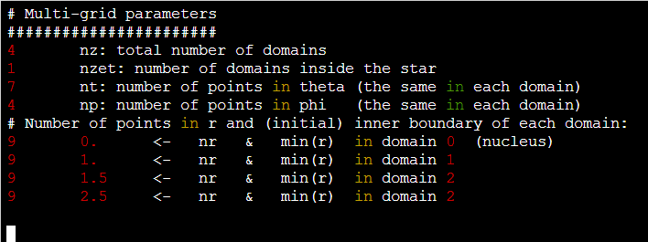
Essential files for BNS ID
../Lorene/Codes/Bin_star
par_grid1.d and par_grid2.d: Grid dimensions, domain radii.

Slide 8
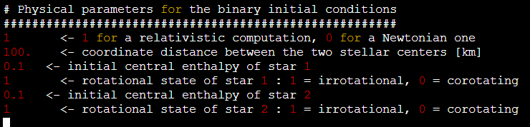
Essential files for BNS ID
../Lorene/Codes/Bin_star
par_init.d : Separation, Central log-enthalpies.

Slide 9
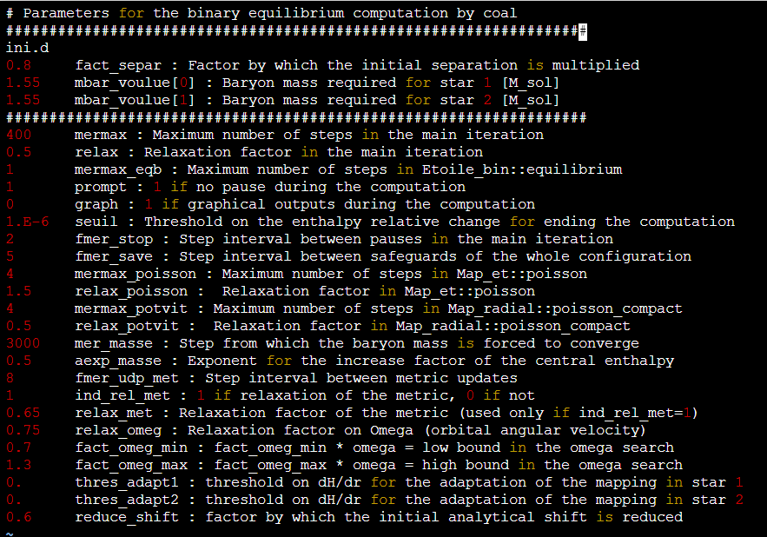
Essential files for BNS ID
../Lorene/Codes/Bin_star
parcoal.d :
fact_separ : revised separation (x 100km)
mbar_voulue : required baryonic masses.

Slide 10
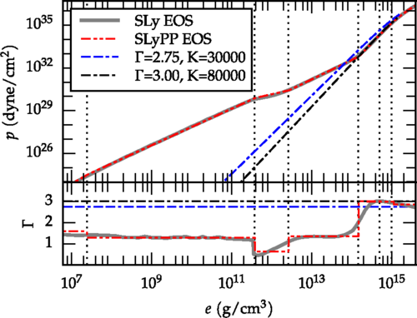
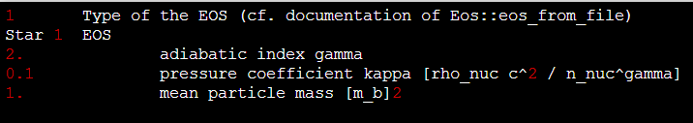

EoS formats supported
Nuclear EoSs $P(ρ, Y_{e}, T)$
EoSs accepted by LORENE in par_eos1.d and par_eos2.d
1. Single Polytropic : $P\left(ρ\right)=κ ρ^{Γ}$
Sample at
../Codes/Bin_star/Parameters/Polytrope_irrot/Test_GR/
Pietri et al. (2016)

Slide 11
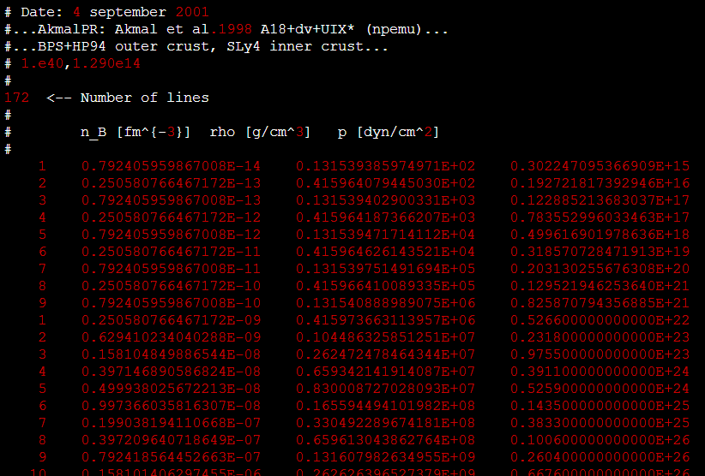

EoS formats supported
EoSs accepted by LORENE in par_eos1.d and par_eos2.d
2. Tabulated EoS :- single temperature Lorene format
with rows :-
# n_B [fm^{-3}] rho [g/cm^3] p [dyn/cm^2]
rho is total energy density = mass + internal energy
../Codes/Bin_star/Parameters/Akmal_irrot/APR_1.35vs1.35_D4R33_60Km/
EoS table at ../Lorene/Eos_tables/eos_akmalpr.d

Slide 12

EoS formats supported
EoSs accepted by LORENE in par_eos1.d and par_eos2.d
3. Tabulated EoS :- CompOSE format
https://compose.obspm.fr/
eos.nb, and eos.thermo
https://lorene.obspm.fr/Refguide/classLorene_1_1Eos__CompOSE.html

Slide 13
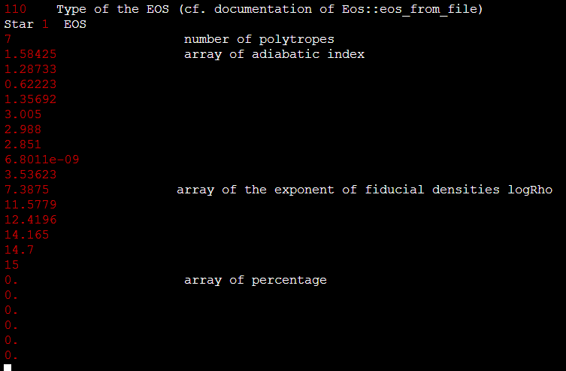
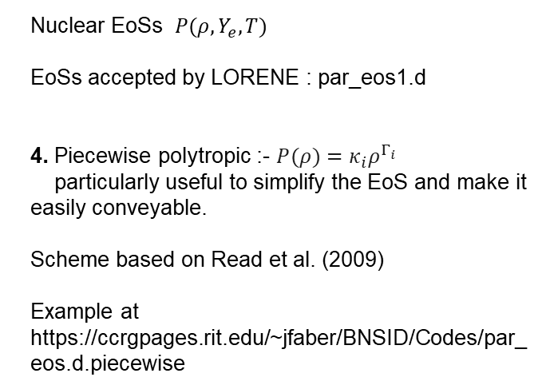
EoS formats supported
Nuclear EoSs $P(ρ, Y_{e}, T)$
EoSs accepted by LORENE : par_eos1.d
4. Piecewise polytropic :- $P(ρ)=κ_{i}ρ^{Γ_{i}}$
particularly useful to simplify the EoS and make it easily conveyable.
Scheme based on Read et al. (2009)
Example at
https://ccrgpages.rit.edu/~jfaber/BNSID/Codes/par_eos.d.piecewise

Slide 14
Generating ID
Place par_eos1.d, par_eos2.d, par_grid1.d, par_grid2.d, par_init.d, parcoal.d
in ../Lorene/Codes/Bin_star/
> ./init_bin
This initializes the binary. ~1 minute to run
> ./coal
Coalesces the binary. ~ few minutes to a couple hours.
The ID file generated is by the name “resu.d”.

Slide 15
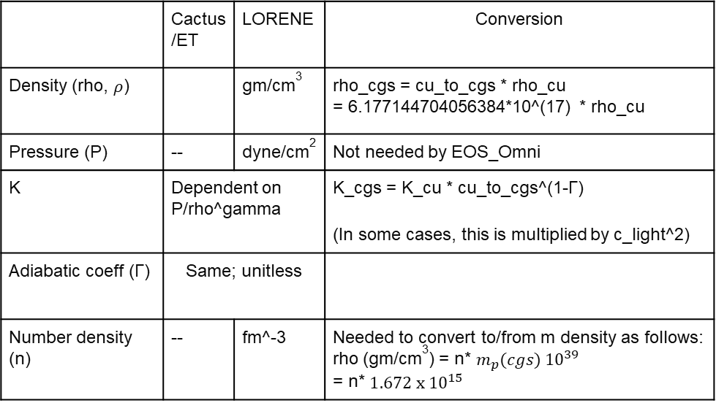
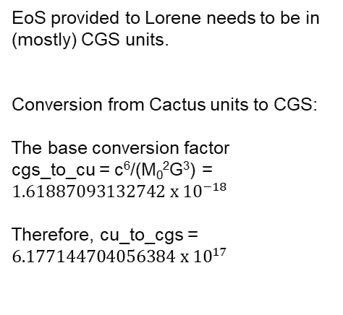
Units
EoS provided to Lorene needs to be in (mostly) CGS units.
Conversion from Cactus units to CGS:
The base conversion factor
cgs_to_cu = c⁶/(M₀²G³) = $1.61887093132742 x {10}^{−18}$
Therefore, cu_to_cgs = $6.177144704056384 x {10}^{17}$
 | Cactus/ET | LORENE | Conversion
Density (rho, $ρ$) |  | gm/cm³ | rho_cgs = cu_to_cgs * rho_cu = 6.177144704056384*10^(17) * rho_cu
Pressure (P) | -- | dyne/cm² | Not needed by EOS_Omni
K | Dependent on P/rho^gamma |  | K_cgs = K_cu * cu_to_cgs^(1-Γ) (In some cases, this is multiplied by c_light^2)
Adiabatic coeff (Γ) | Same; unitless
Number density (n) | -- | fm^-3 | Needed to convert to/from m density as follows: rho (gm/cm³) = n* $m_{p}(cgs) {10}^{39}$ = n* $1.672 x {10}^{15}$

Slide 16
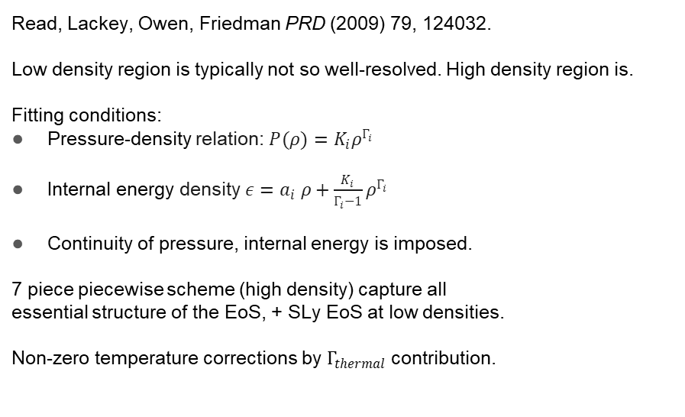
Constructing PP EoSs
Read, Lackey, Owen, Friedman PRD (2009) 79, 124032.
Low density region is typically not so well-resolved. High density region is.
Fitting conditions:
Pressure-density relation: $P(ρ)=K_{i}ρ^{Γ_{i}}$
Internal energy density $ε=a_{i} ρ+\frac{K_{i}}{Γ_{i}−1}ρ^{Γ_{i}}$
Continuity of pressure, internal energy is imposed.
7 piece piecewise scheme (high density) capture all
essential structure of the EoS, + SLy EoS at low densities.
Non-zero temperature corrections by $Γ_{thermal}$contribution.
Maria Hamilton’s PP EoS jupyter nb discusses this scheme at length. Maria_July2021_ETKTalk.ipynb

Slide 17
Resources
[1] LORENE official website https://lorene.obspm.fr/
[2] LORENE Reference manual https://lorene.obspm.fr/Refguide/
[3] Atul Kedia’s documentation : https://docs.google.com/document/d/1NniHTBucMjE14uPBj_YinBE0XvPUgcGAKyVdQXLuJSk/edit?usp=sharing
[4] Josh Faber’s documentation of the workflow : https://www.overleaf.com/project/5c5b52583d92286beaad9930
[5] LORENE’s ID database : https://lorene.obspm.fr/data/ [The database may not open on your default browser.]
[6] CCRG’s database of BNS ID : https://ccrg.rit.edu/content/data/bns-initial-data

Slide 18
Codes to run on the server
Open the terminal and enter this to extract Lorene: > tar -xvf Lorene.tar.gz Then change directory : > cd Lorene/Codes/Bin_star/
Then copy the following files from Bin_star/ET_workshop_2021 directory to Bin_star directory par_eos_4_piecewise.d as par_eos1.d, par_eos2.d par_grid1.d as par_grid1.d and par_grid2.d par_init_ETK.d as par_init.d parcoal_ETK.d as parcoal.d
By using commands like: > cp ET_workshop_2021/par_eos_4_piecewise.d par_eos1.d and so on;
Then run > ./init_bin Takes a few seconds then > ./coal takes about a minute.
The final file named "resu.d" is the Initial Data.

